Slide 1
Thinking of and with data: How students and teachers (and researchers) use data in STEM education
Joshua M. Rosenberg, Doctoral Candidate
Michigan State University
January 24th, 2018
University of Tennessee, Knoxville
Department of Theory and Practice of Teacher Education
Notes:
Work with data
Also implications
Mention NGSS
Make a slide
Thank you to the Mehmet Aydeniz and the search committee and the faculty and students in the TPTE department as well as Ms. Gina Guinn for making this trip possible.
This talk is on thinking of and with data in STEM.
In particular, this talk is focused on the affordances of new sources of data for teachers and students.
And, is on how new sources of data can help us understand teaching and learning in STEM.
Work with data can help students (and teachers) across STEM classrooms to go beyond “doing school” to engage in disciplinary practices, such as analyzing and interpreting data and developing and using models. Using authentic sources of data in classroom contexts can be challenging because of the time and planning such work takes as well as how it differs from how students have traditionally worked with data at school. In this talk, I describe research on how students engage with authentic sources of data in science classrooms and summer STEM enrichment programs. Also, I show how researchers can use a variety of data sources and methods to understand student engagement with data and other science and STEM activities. I discuss implications for teachers, teacher educators and professional development providers, and for the design of educational technologies. Finally, I outline some future directions for uses of data across STEM disciplines.

Slide 2
Research interest
Introduction | Overview | Study 1 | Study 2 | Future Work
At the broadest level, my research examines the role and use of data in K-12 STEM research, teaching, and learning
Taught H.S. Biology, Chemistry, and Earth Science
Motivated by challenges and opportunities from helping students to do science, particularly with technological tools
Apply research to teaching about technology integration in science education, especially on teachers’ Technological Pedagogical Content Knowledge (TPACK)
Notes:
why you went to grad school

Slide 3
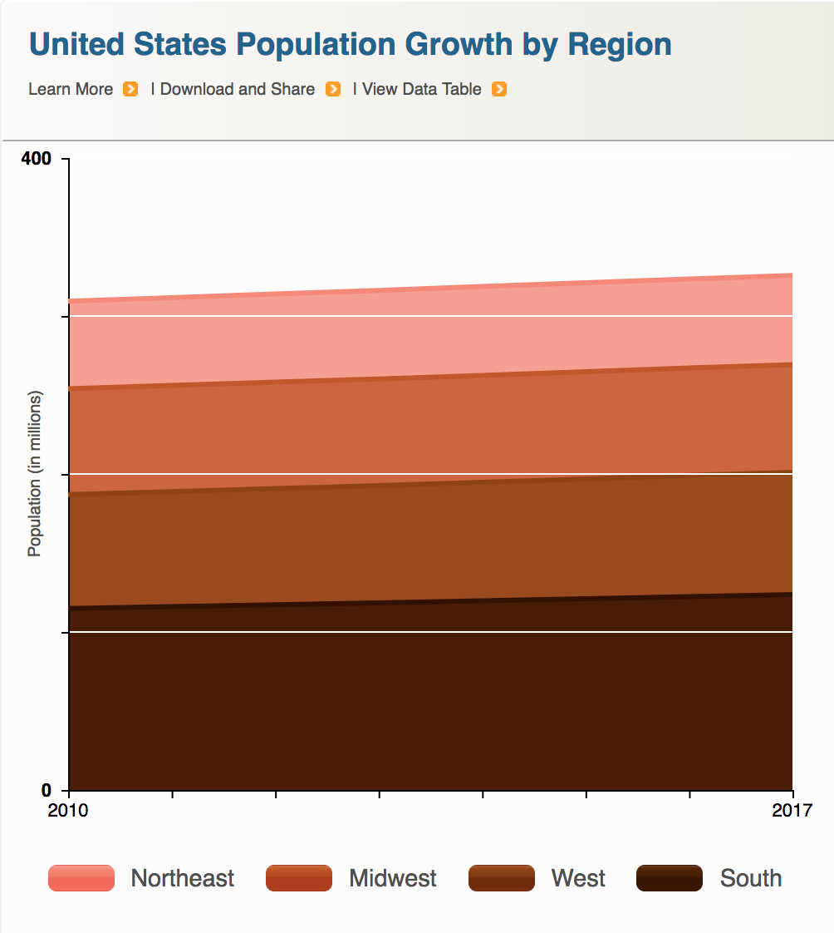
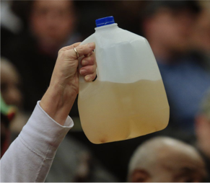

Data is power(ful)
Introduction | Overview | Study 1 | Study 2 | Future Work
Companies
Government
Citizens

Slide 4
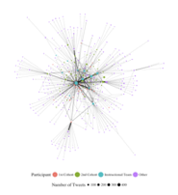
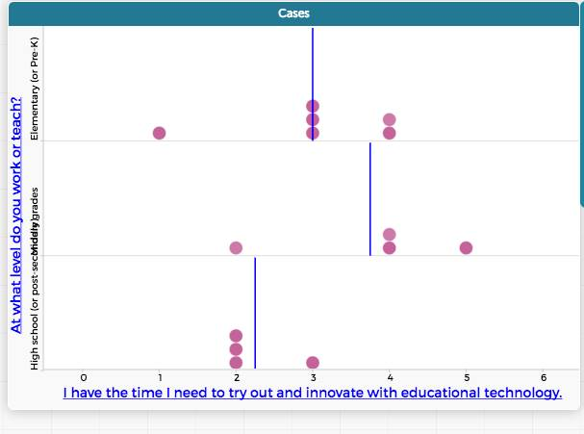
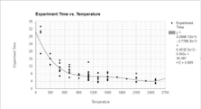
Data is power(ful)
Introduction | Overview | Study 1 | Study 2 | Future Work
Researchers
Teachers
Students
Notes:
talking about agency

Slide 5
My research interest
Introduction | Overview | Study 1 | Study 2 | Future Work
At the broadest level, my research examines the role and use of data in K-12 STEM research, teaching, and learning
Taught H.S. Biology, Chemistry, and Earth Science
Motivated by challenges and opportunities from helping students to do science, particularly with technological tools
Apply research to teaching about technology integration in science education, especially on teachers’ Technological Pedagogical Content Knowledge (TPACK)

Slide 6
Research focused on work with data
Introduction | Overview | Study 1 | Study 2 | Future Work
Students’ Work With Data
Teachers’ Support for Work With Data
Notes:
As you can see, I have a lot of questions and interests about the use of data in science education research, teaching, and learning. I obviously can’t talk about all of these questions today, but I will,
Touch on some of them briefly,
And later, I’ll go into some considerable depth on one of them.

Slide 7
Research focused on work with data
Introduction | Overview | Study 1 | Study 2 | Future Work
Students’ Work With Data
Teachers’ Support for Work With Data
Curricular standards,
resources,
assessments,
and technological tools
Notes:
As you can see, I have a lot of questions and interests about the use of data in science education research, teaching, and learning. I obviously can’t talk about all of these questions today, but I will,
Touch on some of them briefly,
And later, I’ll go into some considerable depth on one of them.

Slide 8
Research focused on work with data
Introduction | Overview | Study 1 | Study 2 | Future Work
Students’ Work With Data
Teachers’ Support for Work With Data
Design and development of contexts and measures for work with data
Curricular standards,
resources,
assessments,
and technological tools
Notes:
As you can see, I have a lot of questions and interests about the use of data in science education research, teaching, and learning. I obviously can’t talk about all of these questions today, but I will,
Touch on some of them briefly,
And later, I’ll go into some considerable depth on one of them.

Slide 9
Students’ work with data
Introduction | Overview | Study 1 | Study 2 | Future Work
How do students collect and analyze data in K-12 classrooms?
How do students work with data as described in the Next Generation Science Standards?
How do students engage in work with data?
What aspects of work with data do students find most challenging?
How can students use new sources of data, such as data from simulations?

Slide 10
Teachers’ support for work with data
Introduction | Overview | Study 1 | Study 2 | Future Work
How can teachers support student work with data?
What aspects of work with data can teachers and teacher educators leverage to support engagement in ambitious practices?
How do teachers with mathematics backgrounds differ in their ability to engage students in work with data?
What support do teachers in summer STEM program provide for students to work with data?

Slide 11
Researchers studying work with data
Introduction | Overview | Study 1 | Study 2 | Future Work
How can researchers study engagement in scientific and engineering practices?
What new forms of data can researchers use to understand education?
How can researchers study authentic artifacts created by teachers and students?
What can digital sources of information tell us about teaching and learning?
What partnerships do researchers need to design and develop contexts for work with data?

Slide 12
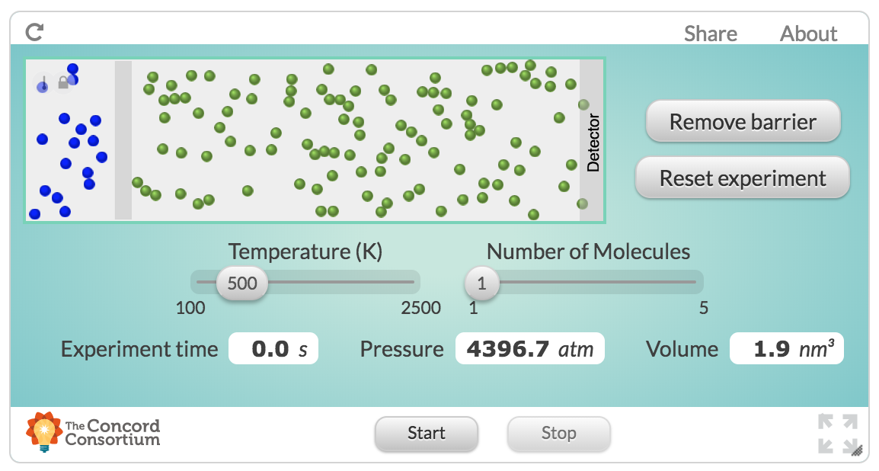
Example: Students’ use of simulations
Introduction | Overview | Study 1 | Study 2 | Future Work
Design activities and tools to make it easier for students to use data in online science classes
How can students use new sources of data, such as data from simulations?
Use of computational data
Students were able to wrangle and model complex data and learn about kinetic-molecular nature of matter
Rosenberg, 2017, MVLRI RPIN

Slide 13
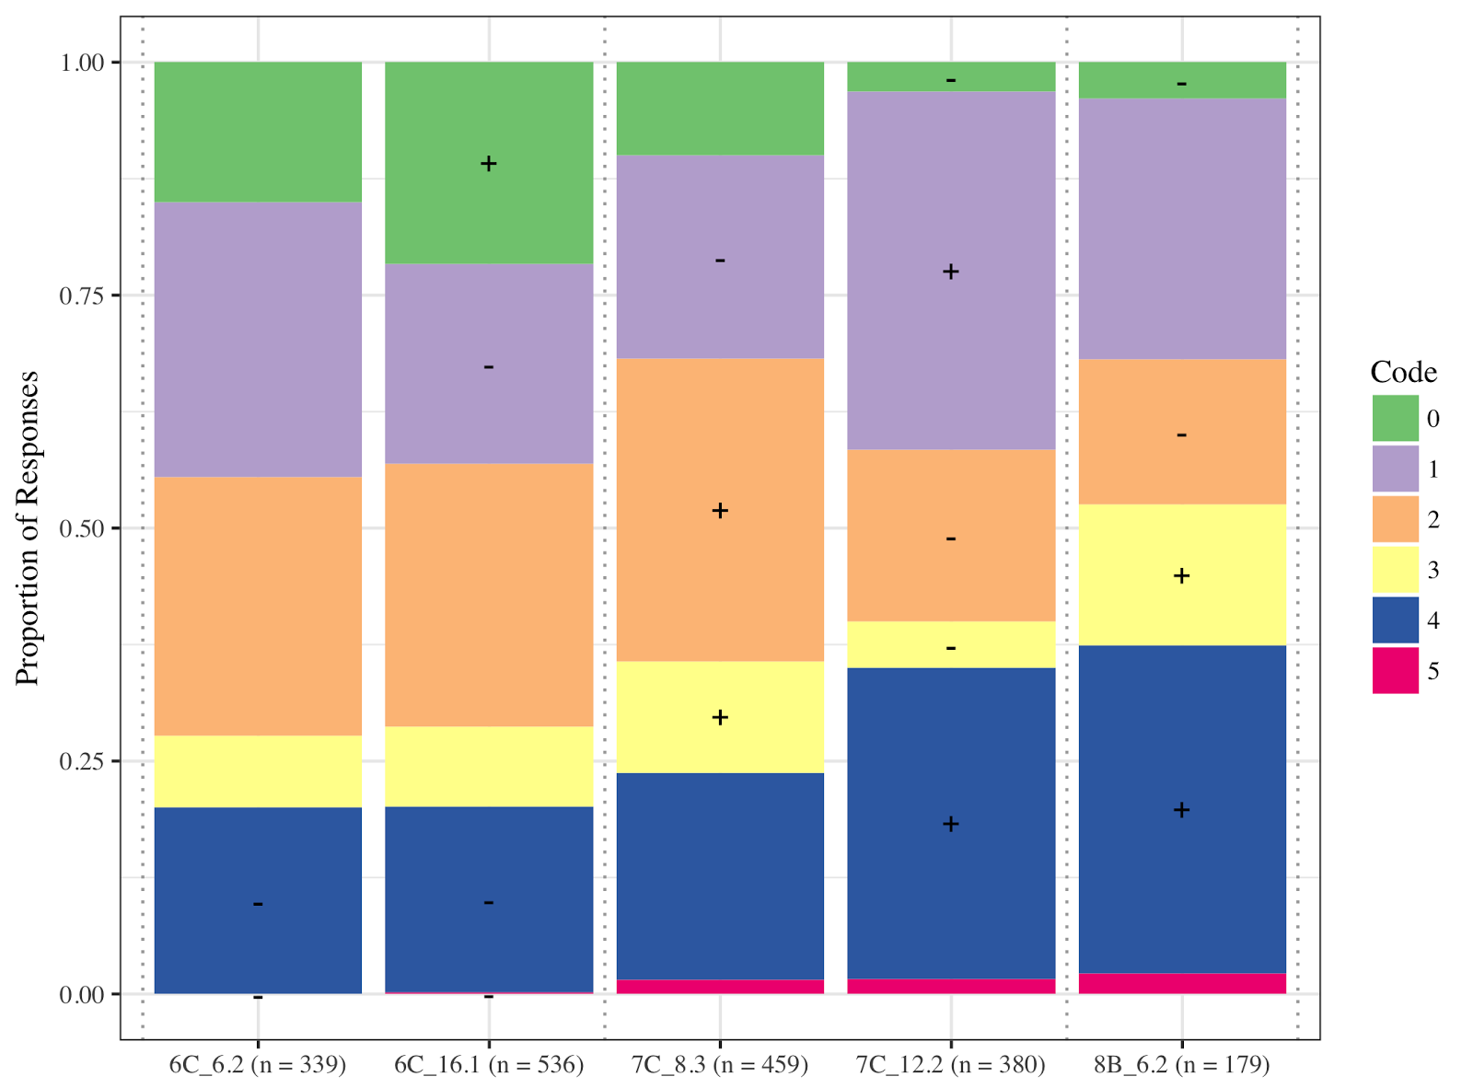
Example: Engaging in scientific practices
Introduction | Overview | Study 1 | Study 2 | Future Work
Study students’ epistemic considerations about scientific practices
How do students work with data as described in the Next Generation Science Standards?
Use of embedded assessment data
Found that students’ advanced in their consideration of generality
Rosenberg & Krist, 2016, April, NARST; Krist & Rosenberg, 2016, July, ICLS

Slide 14
Example: Teacher data modeling
Introduction | Overview | Study 1 | Study 2 | Future Work
Support in-service teachers’ to work with data
How do teachers with mathematics backgrounds differ in their ability to engage students in work with data?
Teacher-collected data and use of the Common Online Data Analysis Platform CODAP)
Found that open-ended work with data with teachers supported sophisticated uses of and rich conversations about data
Rosenberg & Henriksen, in preparation

Slide 15
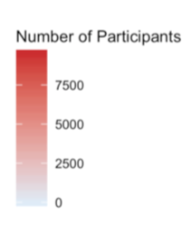
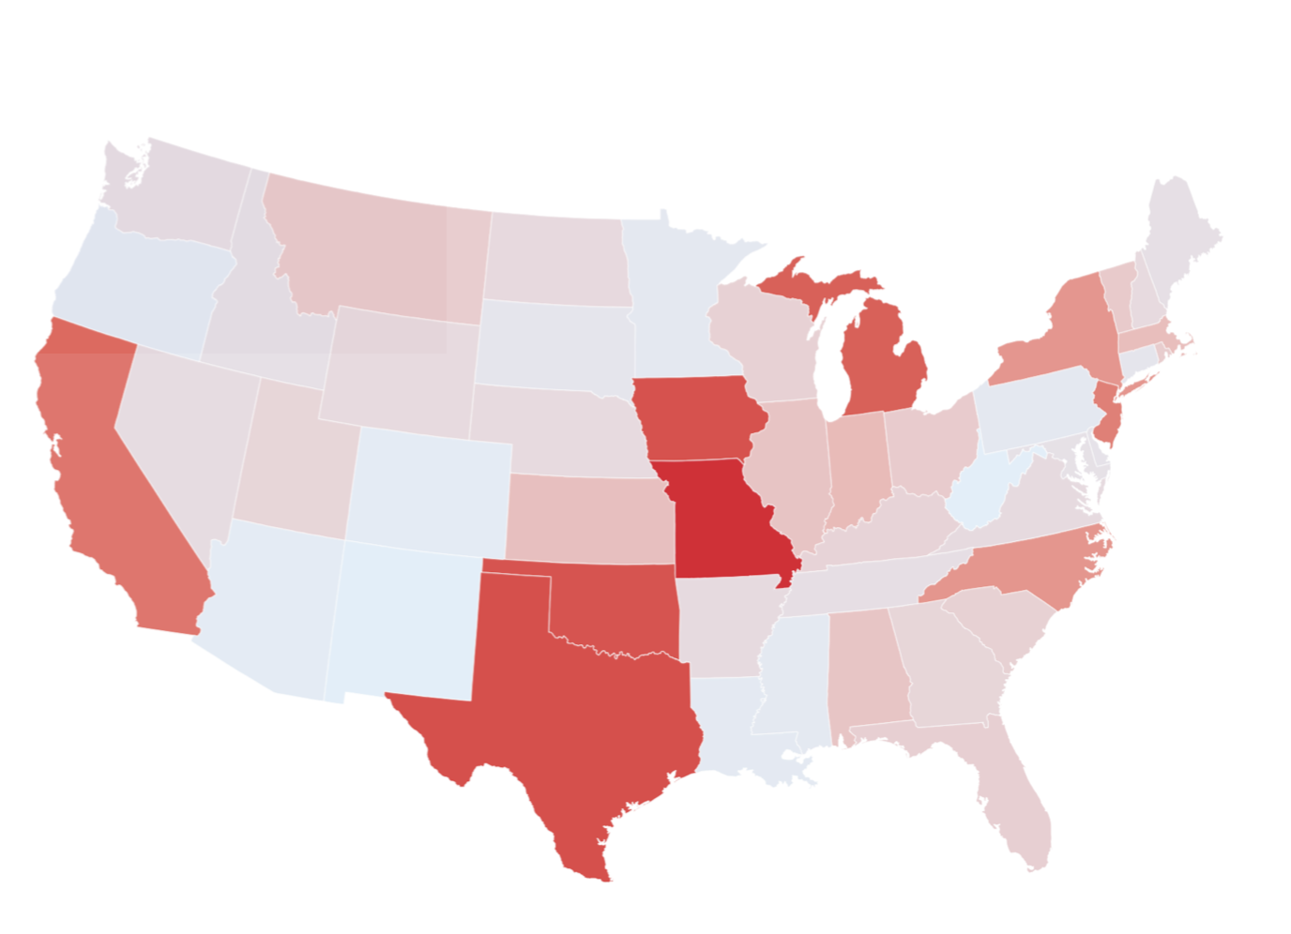
Example: Teachers’ use of Twitter
Introduction | Overview | Study 1 | Study 2 | Future Work
State Educational Twitter Hashtags (SETHs, i.e., #tnedchat) as informal contexts for professional learning
What can digital sources of information tell us about teaching and learning?
500,000+ tweets from around 60,000 unique participants
Found SETHs can serve as potential affinity spaces
Rosenberg, Greenhalgh, Koehler, Hamilton, & Akcaoglu, 2016, EDM

Slide 16
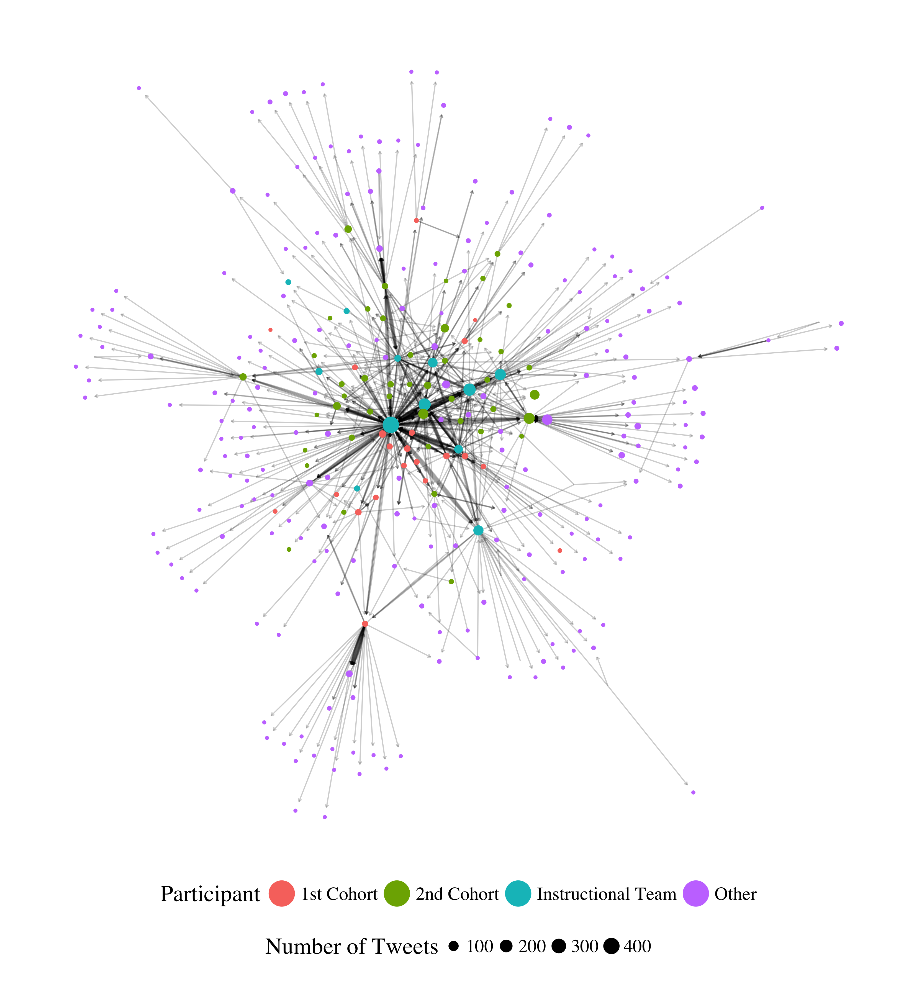
Example: Communities on Twitter
Introduction | Overview | Study 1 | Study 2 | Future Work
Supported development of community across different educational technologies and social media tools (
What can digital sources of information tell us about teaching and learning?
Tweets associated with the #MSUrbanSTEM hashtag
Found that different roles that teachers played in the network
Rosenberg, Greenhalgh, Wolf, & Koehler, 2017, JCMST

Slide 17

Example: Analysis of teachers’ portfolios
Introduction | Overview | Study 1 | Study 2 | Future Work
Assessed teachers’ knowledge through digital portfolios as performance assessments of teachers’ Technological Pedagogical Content Knowledge
How can researchers study authentic artifacts created by teachers and students?
589 digital teaching portfolios
Found that teachers’ could be used to understand teachers’ TPACK
Koehler, Greenhalgh, Rosenberg, & Keenan, 2016, JTATE

Slide 18
Example: Students’ essays
Introduction | Overview | Study 1 | Study 2 | Future Work
Examined changes in middle school science students’ value and interest in science through a relevance intervention
What can digital sources of information tell us about teaching and learning?
Written statements about the usefulness of what students were learning
Students’ demonstrated different levels of cognitive processing (12.08% of text instead compared to 9.27% of text, t = 2.81; p < .05, d = .50)
“If I am ever blowing up balloons for a party and I want to keep the balloons big, I will keep them in a warm room so the molecules speed up and spread out, hitting the sides of the balloons and expanding it. In a cold room, the molecules will slow down and come together and the balloons sides will close and become smaller.”
Akcaoglu, Rosenberg, Ranellucci, & Schwarz, 2018, IJER

Slide 19
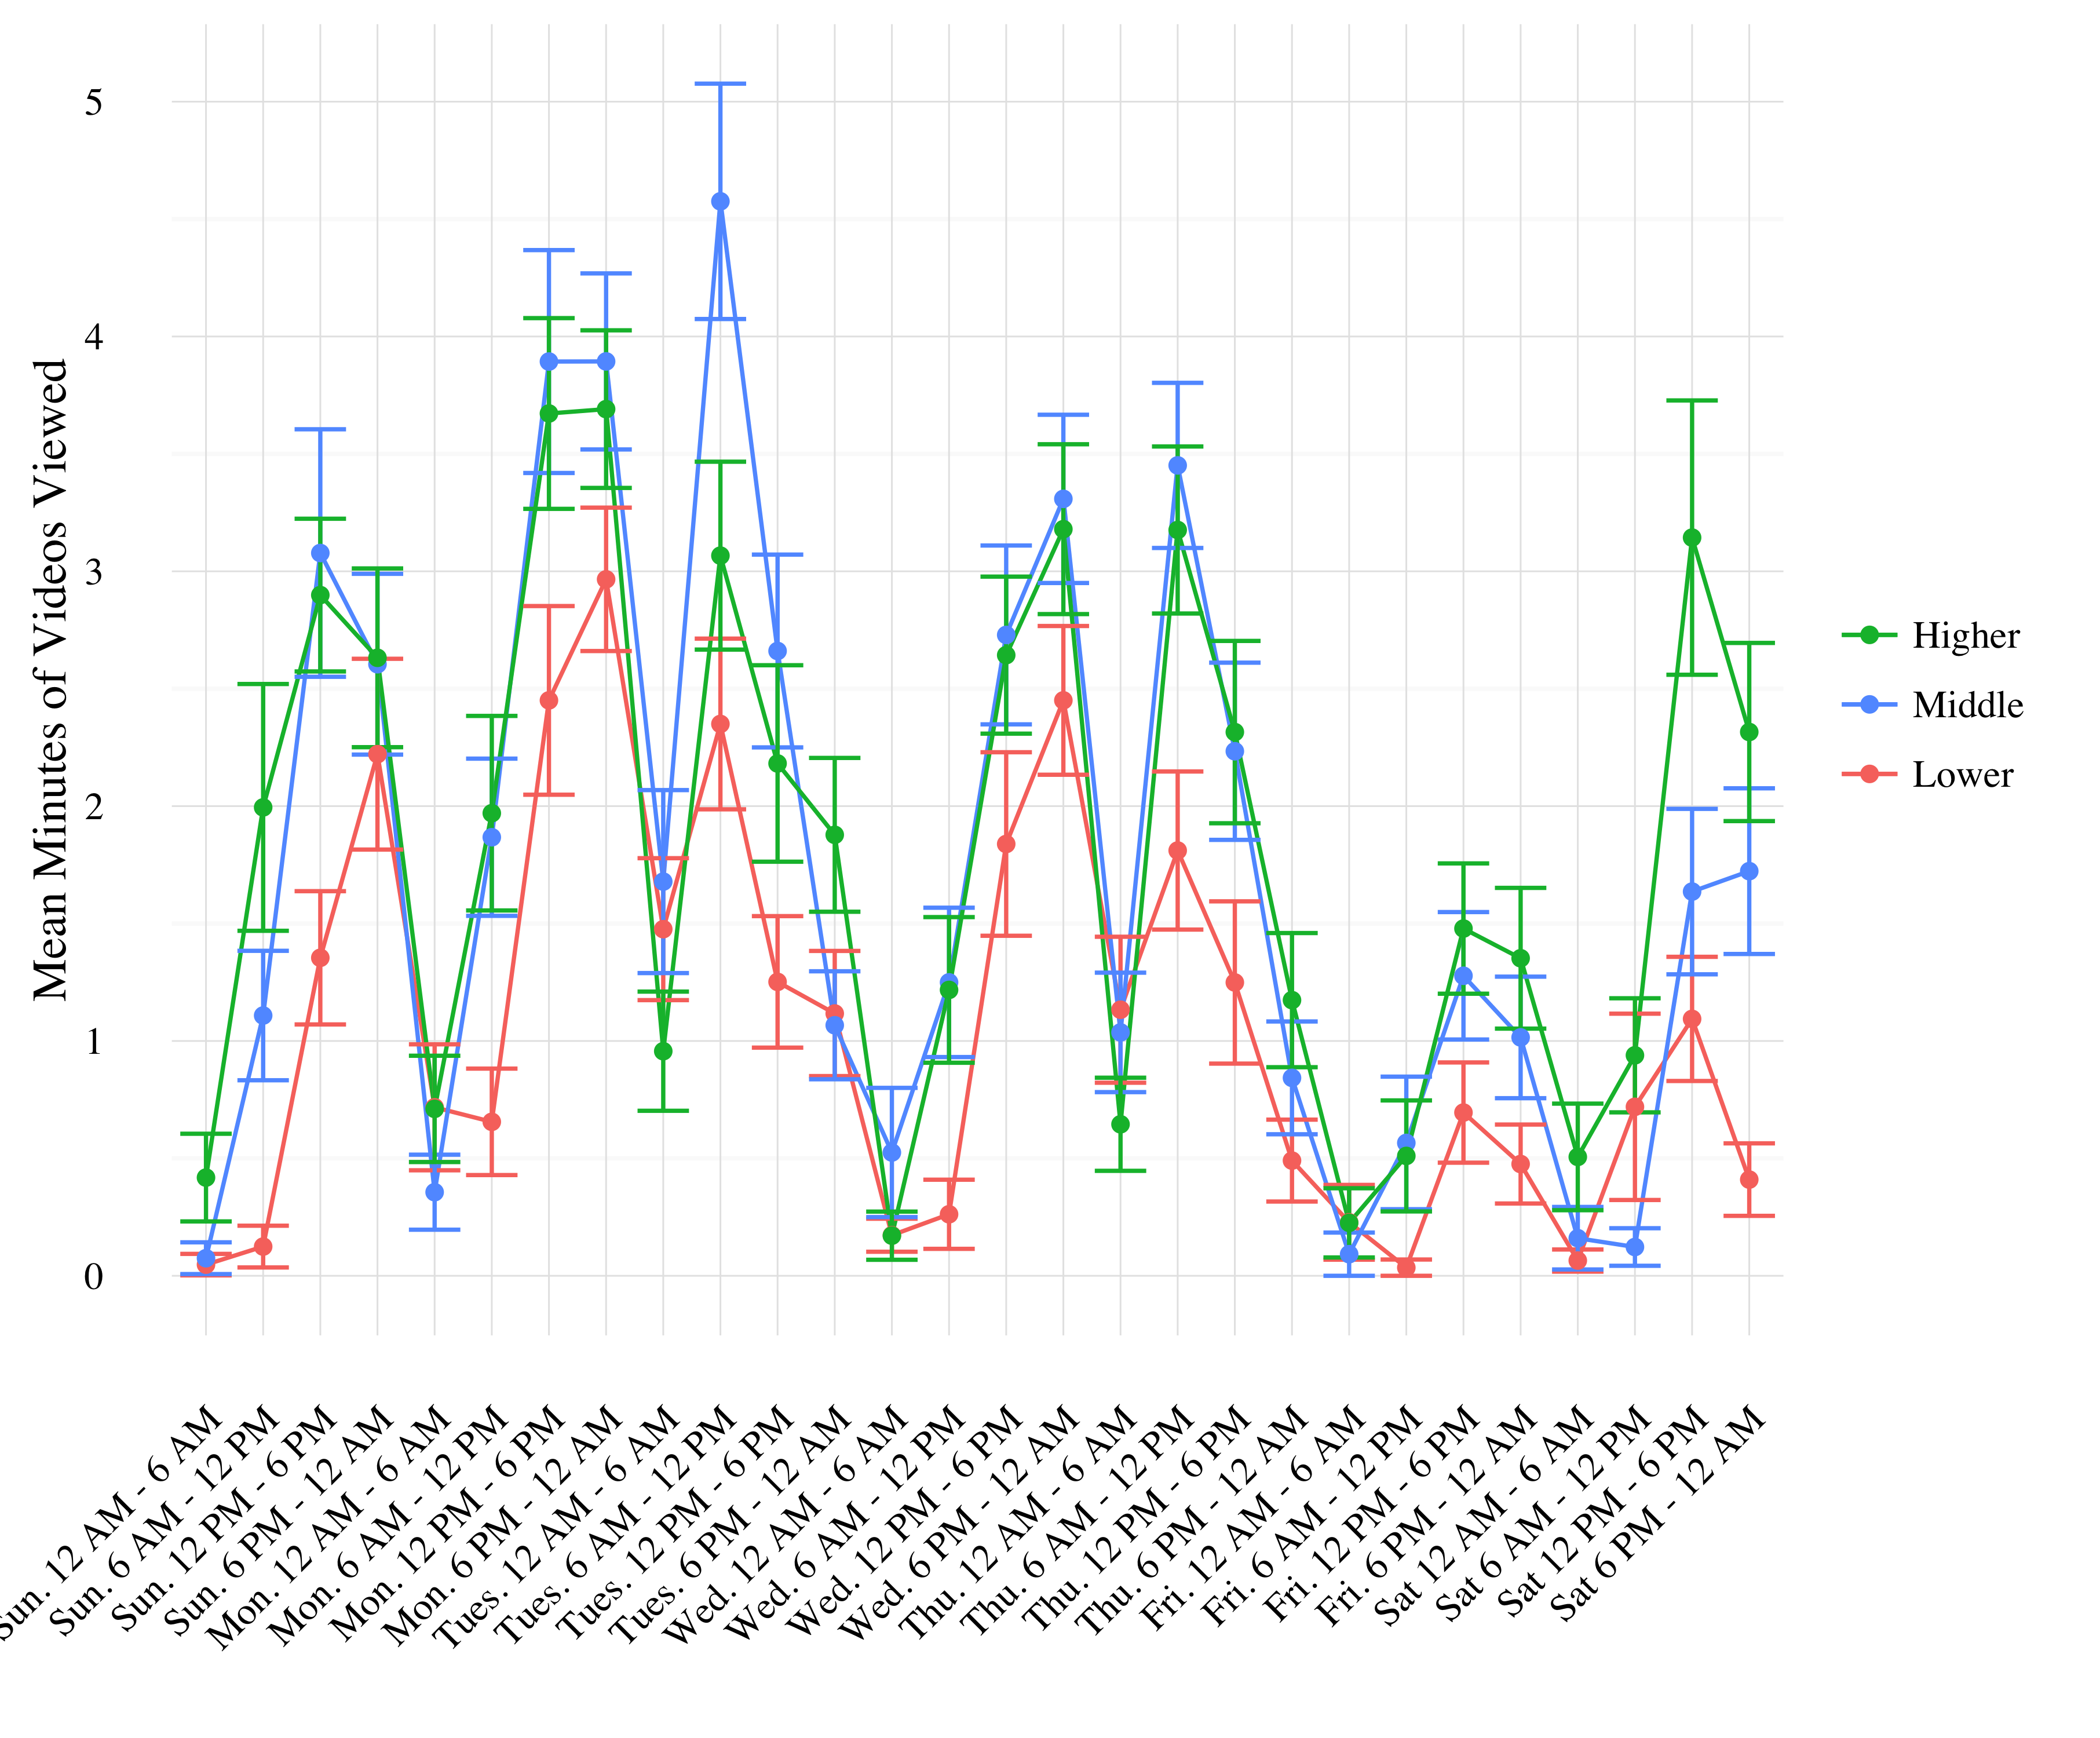
Example: Engagement in flipped classes
Introduction | Overview | Study 1 | Study 2 | Future Work
Explore patterns of engagement in- and out- of flipped undergraduate anatomy class
What new forms of data can researchers use to understand education?
Use of log-trace data
Found that “crammers” were less-likely to perform well in the course
Rosenberg, Lee, Robinson, Ranellucci, Roseth, & Linnenbrink-Garcia, 2018, April, AERA

Slide 20
Introduction | Overview | Study 1 | Study 2 | Future Work
How do K-12 students who work with data in science education engage in their learning?
Overview
Notes:
For the rest of this talk, I want to zoom in one particular set of questions.

Slide 21

Work with data
Introduction | Overview | Study 1 | Study 2 | Future Work

Slide 22
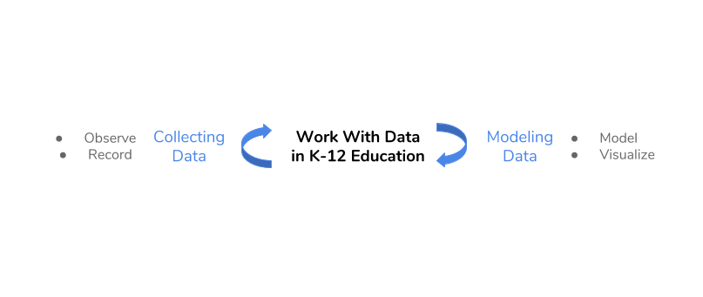
Work with data
Introduction | Overview | Study 1 | Study 2 | Future Work

Slide 23
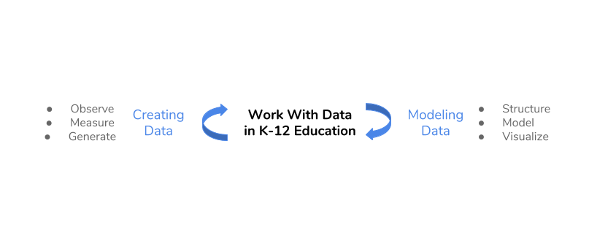
Work with data
Introduction | Overview | Study 1 | Study 2 | Future Work

Slide 24
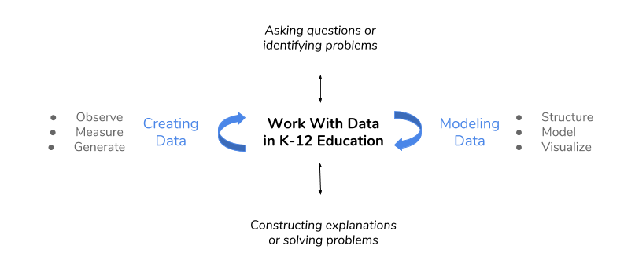
Work with data
Introduction | Overview | Study 1 | Study 2 | Future Work
Hancock, Kaput, & Goldsmith, 1992; Wild & Pfannkuch, 1999
NGSS Lead States, 2013; National Research Council, 2012

Slide 25
Two studies
Introduction | Overview | Study 1 | Study 2 | Future Work
Two studies to explore these set of issues
Study 1:
Study 2:

Slide 26
STUDY ONE
Introduction | Overview | Study 1 | Study 2 | Future Work
Explored “business-as-usual” and hands-on science, activities using a person-in-context approach (Schmidt, Rosenberg, & Beymer, 2018, JRST)
Tell about the classroom, students, what was “science” in these classrooms (i.e., what was “business as usual”)
Notes:
Demonstrate how data can be used to empower teachers and students.
What role this play

Slide 27
Context and Sample
Introduction | Overview | Study 1 | Study 2 | Future Work
12 high school classrooms
Large high school outside of a large metropolitan area
244 students
Notes:
Measures:
Experience Sampling Method for engagement and choice
Activities coded from video-recordings
Person-in-context approach:
Two step cluster analysis (Rosenberg, Schmidt, & Beymer, 2017)
Interpreted profile solutions on the basis of measures of fit, cross-validation, and concerns of parsimony

Slide 28
Research question
Introduction | Overview | Study 1 | Study 2 | Future Work
To understand how learning activities (e.g., laboratory activities or lecture) and being able to choose impact students’ engagement
Notes:
Demonstrate how data can be used to empower teachers and students.
What role this play

Slide 29
Experience sampling method (ESM)
Introduction | Overview | Study 1 | Study 2 | Future Work
Involves asking people about their experiences using short surveys
Use of an app on phone
Every 15-30 minutes
“When you were signaled, how interested were you in what you were learning?”
Notes:
To look at this question, we also had to think hard about data, and new sources of data. We used a relatively new type of data called ESM.

Slide 30
Why ESM?
Introduction | Overview | Study 1 | Study 2 | Future Work
Understand learning experiences in a qualitatively distinct way (Hektner, Schmidt, & Csikszentmihalyi, 2007)
Helps us to understand moment-to-moment changes in experiences and what impacts experiences
Allows us to understand experiences during activities rather than overall pre- and post-assessments of what did or did not work
Notes:
I know this past research is a stretch – I would like to keep this just for the moment :)
Importance (but under-emphasis on) context in research on teacher knowledge (Rosenberg & Koehler, 2015)
Role of context in explaining processes around teaching and learning with technology (Phillips, Koehler, & Rosenberg, 2016)

Slide 31
Constructing Profiles
Introduction | Overview | Study 1 | Study 2 | Future Work
Cognitive, Behavioral, and Affective Engagement
Explain how you get profiles
Why?
Notes:
I know this past research is a stretch – I would like to keep this just for the moment :)
Importance (but under-emphasis on) context in research on teacher knowledge (Rosenberg & Koehler, 2015)
Role of context in explaining processes around teaching and learning with technology (Phillips, Koehler, & Rosenberg, 2016)

Slide 32
Coding of Data Practices
Introduction | Overview | Study 1 | Study 2 | Future Work
Work With Data | Description
Asking questions or defining problems | Discussing and exploring topics to investigate and pose questions.
Making observations | Watching and noticing what is happening with respect to the phenomena or problem being investigated.
Generating data | Figuring out how or why to record an observation as data and generating coding frames or measurement tools.
Data modeling | Understanding and explaining phenomena using models of the data that account for variability or uncertainty.
Interpreting and communicating findings | Discussing and sharing and presenting findings.
Notes:
Instead of categorizing things by laboratory, individual work, etc., we categorized by these six categories which represent different data practices

Slide 33
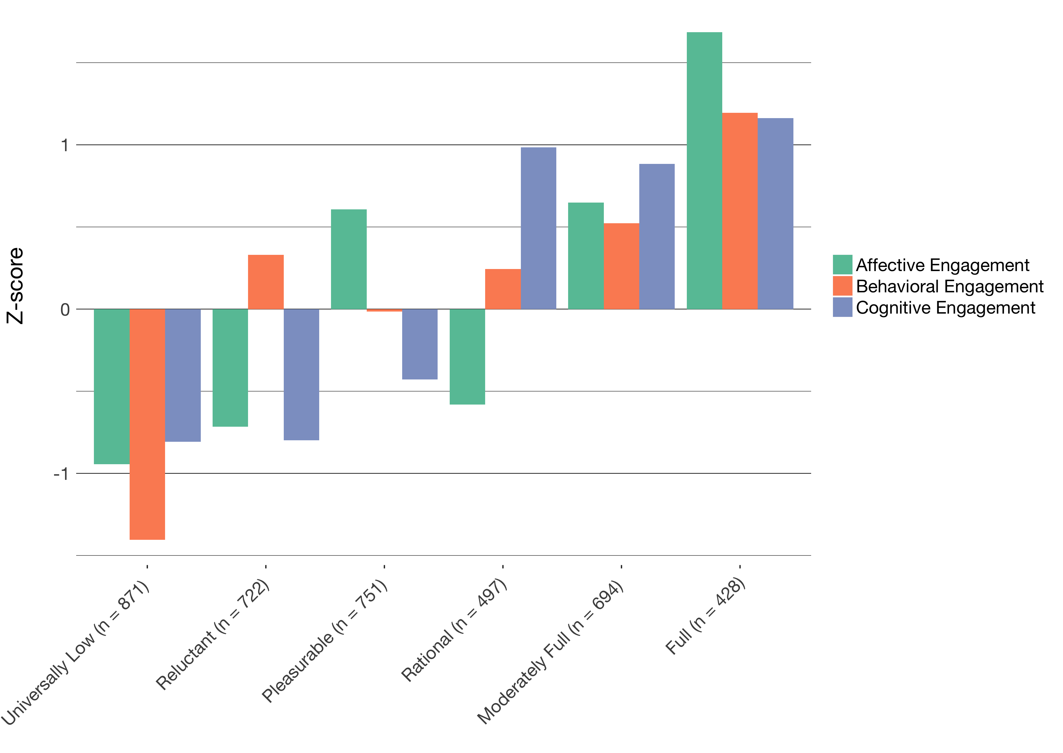
Profiles of engagement
Introduction | Overview | Study 1 | Study 2 | Future Work
Identified momentary profiles of engagement
Found six profiles from Universally Low to Full, with four complex patterns
Note that students report multiple profiles

Slide 34

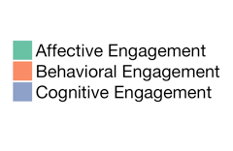
Universally Low
Introduction | Overview | Study 1 | Study 2 | Future Work
What this means

Slide 35
Reluctant
Introduction | Overview | Study 1 | Study 2 | Future Work
What this means

Slide 36
Etc
Introduction | Overview | Study 1 | Study 2 | Future Work
What this means

Slide 37
Profiles of engagement
Introduction | Text | ESM | Digital Traces | Future Work | Conclusion
Identified momentary profiles of engagement
Found six profiles from Universally Low to Full, with four complex patterns
Note that students report multiple profiles

Slide 38
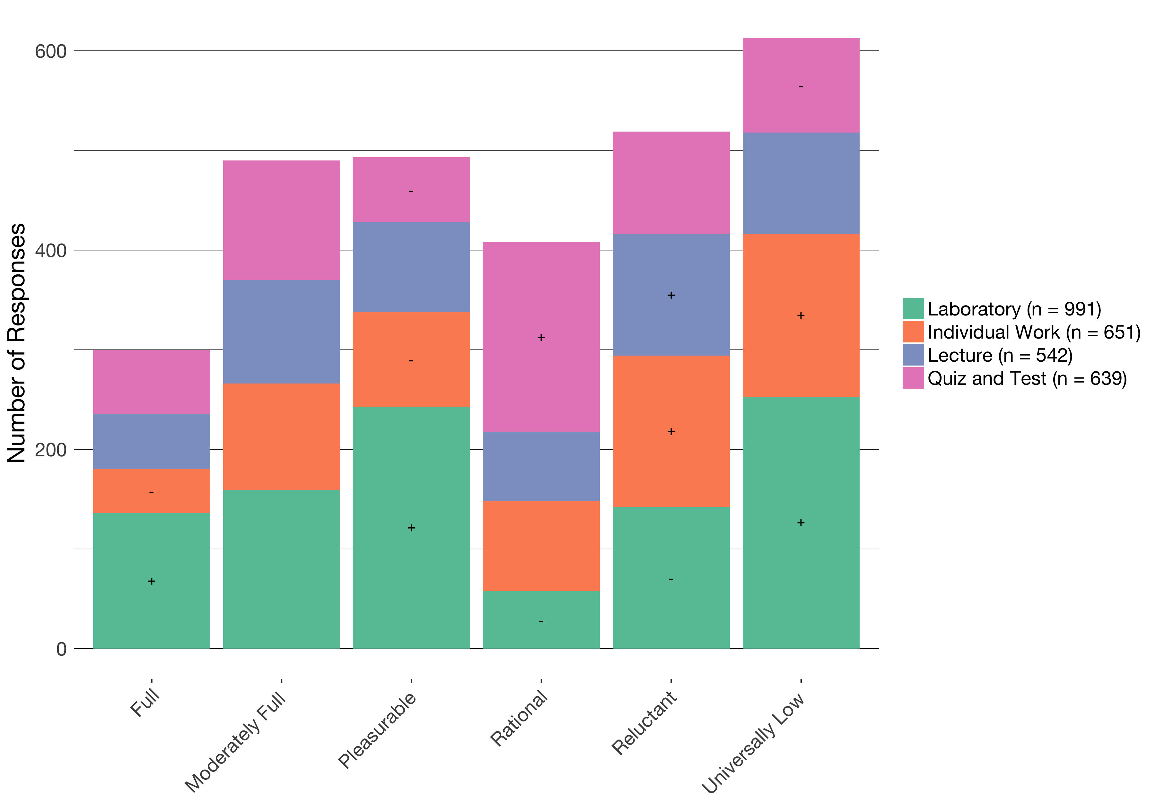
Profiles by activity
Introduction | Text | ESM | Digital Traces | Future Work | Conclusion
Notes:
Say more. About individual work.

Slide 39
The impacts of activity on engagement
Introduction | Text | ESM | Digital Traces | Future Work | Conclusion
Different activities in science are associated with different profiles of engagement
Laboratory activities can be particularly engaging (and disengaging)
Quizzes and tests have some affordances in terms of students’ engagement
Individual work can be particularly disengaging

Slide 40
Profiles by choice
Introduction | Text | ESM | Digital Traces | Future Work | Conclusion
Notes:
REMAKE THIS GRAPH BY CHOICE.

Slide 41
The impacts of choice on engagement
Introduction | Text | ESM | Digital Traces | Future Work | Conclusion
Choosing with whom to work is not associated with higher engagement
Choosing how much time to take is associated with rational engagement
Choosing how to do an activity or what the purpose or topic of the activity is associated with engaging profiles

Slide 42
Summary
Introduction | Text | ESM | Digital Traces | Future Work | Conclusion
Using the right kind of data, ESM, allowed us to study the impacts of the learning activity and choice when students work with data
Different activities in science are associated with different profiles of engagement
Providing chances for students to decide what to do or how to do it also impacts their engagement
As students move from activity to activity, their engagement can change
Notes:
Laboratory activities in science can be highly engaging
Choice—especially related to how students do laboratory activities and who determines how the activities is framed (choosing the purpose or topic)—is a key factor affecting how engaging laboratory activities are
Person-in-context approach helped us to characterize distinct profiles of engagement

Slide 43
STUDY 2
Introduction | Text | ESM | Digital Traces | Future Work | Conclusion
Explored “business-as-usual” and hands-on science, activities using a person-in-context approach (Schmidt, Rosenberg, & Beymer, 2018, JRST)
Tell about the classroom, students, what was “science” in these classrooms (i.e., what was “business as usual”)
Notes:
Demonstrate how data can be used to empower teachers and students.
What role this play

Slide 44
Context and Sample
Introduction | Text | ESM | Digital Traces | Future Work | Conclusion
12 high school classrooms
Large high school outside of a large metropolitan area
244 students
Notes:
Context and Participants:
Nine summer STEM programs in urban areas in the Northeast
Highly diverse (90% of youth from historically under-represented [in STEM] groups)
204 youth, 2970 ESM responses

Slide 45
Research Question
Introduction | Text | ESM | Digital Traces | Future Work | Conclusion
To understand how data practices (e.g., collecting, analyzing, interpreting, etc.) impact students’ engagement
Notes:
Demonstrate how data can be used to empower teachers and students.
What role this play

Slide 46
Experience sampling method (ESM)
Introduction | Text | ESM | Digital Traces | Future Work | Conclusion
Notes:
Like the previous study, the data we used to answer this question was ESM.

Slide 47
Constructing Profiles
Introduction | Text | ESM | Digital Traces | Future Work | Conclusion
Cognitive, Behavioral, Affective, Challenge, and Competence
Explain how you get profiles
Why?
Notes:
Measures:
ESM self-reports for cognitive, behavioral, and affective and perceptions of challenge and competence
Video-recordings of activities
Pre-program measures of interest

Slide 48
Coding of Data Practices
Introduction | Text | ESM | Digital Traces | Future Work | Conclusion
Work With Data | Description
Asking questions or defining problems | Discussing and exploring topics to investigate and pose questions.
Making observations | Watching and noticing what is happening with respect to the phenomena or problem being investigated.
Generating data | Figuring out how or why to record an observation as data and generating coding frames or measurement tools.
Data modeling | Understanding and explaining phenomena using models of the data that account for variability or uncertainty.
Interpreting and communicating findings | Discussing and sharing and presenting findings.
Notes:
Instead of categorizing things by laboratory, individual work, etc., we categorized by these six categories which represent different data practices

Slide 49
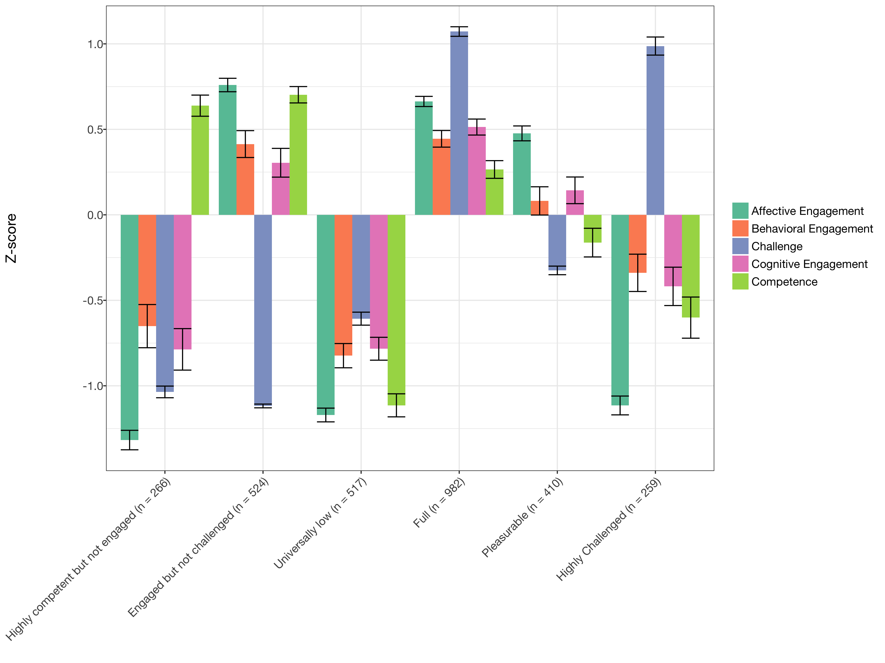
Profiles of engagement and its conditions
Introduction | Text | ESM | Digital Traces | Future Work | Conclusion
Developed tool for Latent Profile Analysis
Interpreted profiles using multiple criteria
Notes:
Do whatever you did in Study one to present these profiles. (Breaking into 6 slides, and 7th that puts them back together)

Slide 50
What the profiles tell us
Introduction | Text | ESM | Digital Traces | Future Work | Conclusion
When learners are challenged, they also need to think themselves as good at what they are doing to be highly engaged
When learners report Pleasurable engagement, their behavioral and cognitive engagement and perceptions of being challenged or good at the activity are moderate
When students report being Engaged but not Challenged, they may not be engaged in learning-related processes
Notes:
Mention more general findings

Slide 51
Engagement by Data Practice
Introduction | Text | ESM | Digital Traces | Future Work | Conclusion
Notes:
REMAKE THIS GRAPH BY DATA PRACTICE

Slide 52
Findings
Introduction | Text | ESM | Digital Traces | Future Work | Conclusion
When students report being Fully engaged:
Students are more likely to be generating data (B = 1.395, p = .029) and less likely to be observing phenomena (B = 0.410, p = .028)
Qualitative analysis of video suggests that modeling data is more often done by teachers (not students)
Notes:
6 profiles, model 2, estimated in Mplus via tidyLPA
Change the order of the clustered variables
Need to name the profiles

Slide 53
Summary
Introduction | Text | ESM | Digital Traces | Future Work | Conclusion
Studying engagement at the moment-to-moment level helps us understand how specific activities related to work with data engage learners
Some aspects of work focused on generating or recording data are more engaging than others
Notes:
Combine the three previous slides into to two. Make clear statements that will impress the audience. Aim to impress a 12th grader.

Slide 54
Future work
Supporting students to do data science
Supporting teachers to work with data
Leveraging the network effect to scale innovations

Slide 55
Helping Teachers
Taking the results of the ESM studies and thinking forward about what teachers need to know, and what help we can give them to pull it off.

Slide 56
Supporting students to do data science
Introduction | ESM | Text | Digital Traces | Future Work | Conclusion
Past studies were not in contexts not designed and developed to help teach students data science
Build on collaboration with Michigan Virtual School (Rosenberg, 2017, MVLRI RPIN) to design activities and tools to make it easier for students to use data in online science classes
Focus on data wrangling (accessing, organizing, and transforming data) to expand opportunities to work with data
Partner with faculty across departments at University of Tennessee, Knoxville to support and document work with data at post-secondary level
Strong potential for funding (NSF DRK-12)

Slide 57
Supporting teachers to work with data
Introduction | ESM | Text | Digital Traces | Future Work | Conclusion
Teachers find the shift toward more open-ended work with data to be challenging and working with teachers to study and show how these activities are possible is important
Engage pre-service and in-service teachers in coursework and opportunities to ”hands-on” work with data
Explore how work with in mathematics and engineering classes allows learners to more deeply engage in science as part of a positive “feedback loop”
Potential for collaborative work across the Theory and Practice of Teacher Education department and impact on teacher preparation coursework
Opportunities to involve teachers in design and development of technological tools (i.e., support TPACK)

Slide 58
Leveraging the network effect
Introduction | ESM | Text | Digital Traces | Future Work | Conclusion
Scale innovations in STEM teaching and learning through Digital Traces
Understand how involvement in formal and informal digital communities supports changes in practice
Understand how access to specific resources or people at specific times impacts involvement in a community
Opportunities for expanding impact and carrying out research through foundations (Gates Foundation and programs focused on addressing equity through Digital Traces of researchers, administrators, and practitioners)

Slide 59
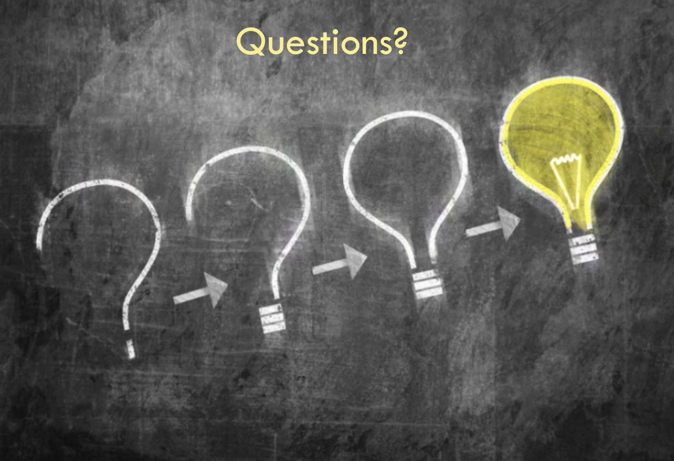
Introduction | ESM | Text | Digital Traces | Future Work | Conclusion
Thank you to participating teachers and students and to collaborators!
Joshua Rosenberg jrosen@msu.edu
http://jmichaelrosenberg.com
@jrosenberg6432
Michigan State University
Notes:
Demonstrate how data can be used to empower teachers and students.

Slide 60
References
Introduction | ESM | Text | Digital Traces | Future Work | Conclusion
Cobb et al., 2003
Turner & Noley, 2015
Mishra, Koehler, & Greenhow, 2016
NGSS Lead States, 2015
National Research Council, 2012
Severance et al., 2012
Wilkerson-Jerde & Wilensky, 2015
Rosenberg & Koehler, 2015
Rosenberg et al., 2016
Koehler et al., 2016
Schmidt, Rosenberg, & Beymer, 2018
Beymer, Rosenberg, & Schmidt, in press
Akcaoglu, Rosenberg, Ranellucci, & Schwarz, 2018
Notes:
Demonstrate how data can be used to empower teachers and students.

